Slide 1

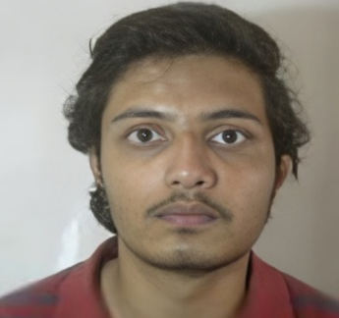
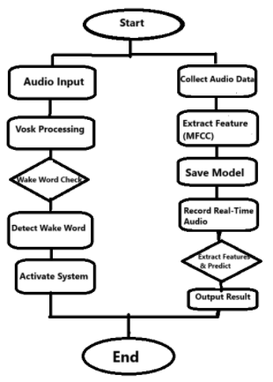
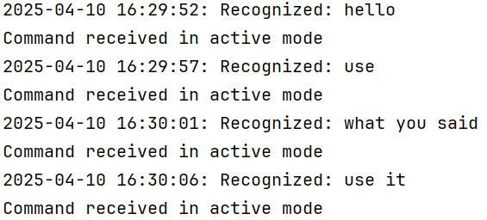
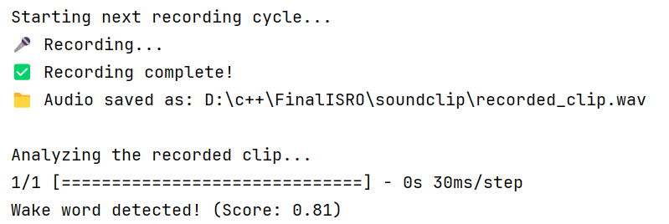
DEVELOPMENT OF WAKEUP WORD DETECTION MODEL
FOR VOICE COMMANDING SYSTEM
PCSVD-PCEG-SEDA
Name: Aryan Singh
Designation: Researcher/Intern
Institution: Mohanlal Sukhadia University, Udaipur
Guide: Smt. Nutan Kumari
Contact e-mail: nutan@sac.isro.gov.in
PHOTO
MAJOR OBJECTIVES:
Develop an efficient wake word detection model.
Train a custom model using collected audio data.
Implement real-time detection with low latency for payload activation.
02 JAN 2025 to
11 APR 2025
METHODOLOGY FLOW CHART: Vosk and Custom Model flow Chart
RESULTS/MAJOR FINDINGS:
Vosk Working Custom-Model Working
dddddd
Custom wake word detection model outperformed Vosk in efficiency and accuracy.
Achieved up to [insert %] test accuracy using CNN with MFCC features.
Data augmentation (white noise, time shifting) improved model robustness despite limited data.
Real-time detection system successfully implemented, though constrained by low system specs.
Model showed potential for voice-activated payload systems but requires more data for generalization.
CONCLUSION: Development a wake word detection model, improving on the inefficient Vosk approach.
Achieved objectives with a custom CNN and real-time prediction system.
Future enhancements will boost practical utility.

